Slide 1
Emblems and
Feature-based Image similarity search

Slide 2
Agenda
Introduction
Research
Question
Methods
Evaluation
Conclusions
Notes:
2

Slide 3
Why an image search?
Introduction
In 2017, 63% of requests concern images (source: gallica.bnf.fr).
The iconographic search provides a complementary information to the textual content.
Image similarity search starting from query image.
Automatic indexing and classification of image database.
Automatic extraction of iconographic elements in all collections and in all documents type.
Research Question
Methods
Evaluation
Conclusions

Slide 4
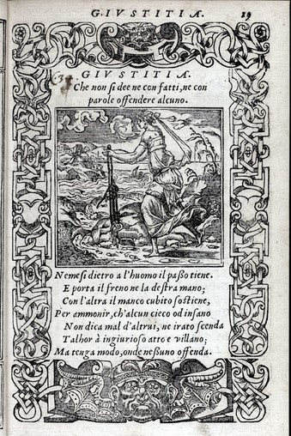
Introduction
Emblem
Research Question
Motto (latin) or Inscriptio (vernacular)
Methods
Pictura (enigmatic picture)
Evaluation
Subscriptio (epigram- vernacular)
Conclusions

Slide 5
Introduction
Emblem → Pictura
Research Question
Motto (latin) or Inscriptio (vernacular)
Methods
Pictura (enigmatic picture)
Evaluation
Subscriptio (epigram- vernacular)
Conclusions

Slide 6
Database:
Introduction
28413 Emblems
1388 freely accessible facsimiles of emblem books
Iconclass index for a total of 32.752 distinct Iconclass notations
Search for motto, keyword, Iconclass notation, and Iconclass term
Different scan standard: 300dpi, JPEG2000, tiff. On internet reduced in size and converted into JPEG
Research Question
Methods
Evaluation
Conclusions

Slide 7
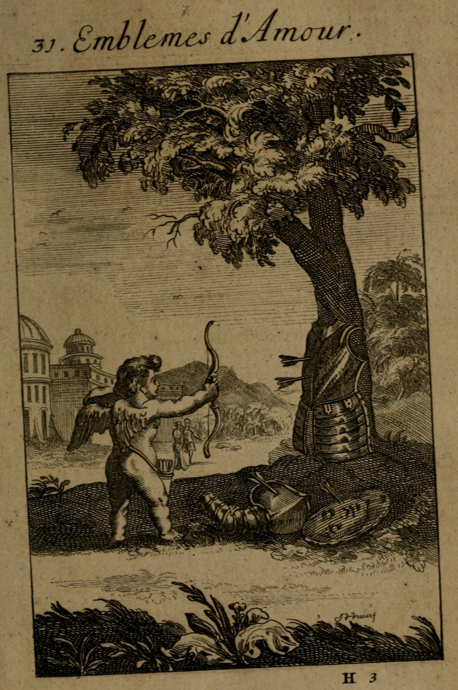
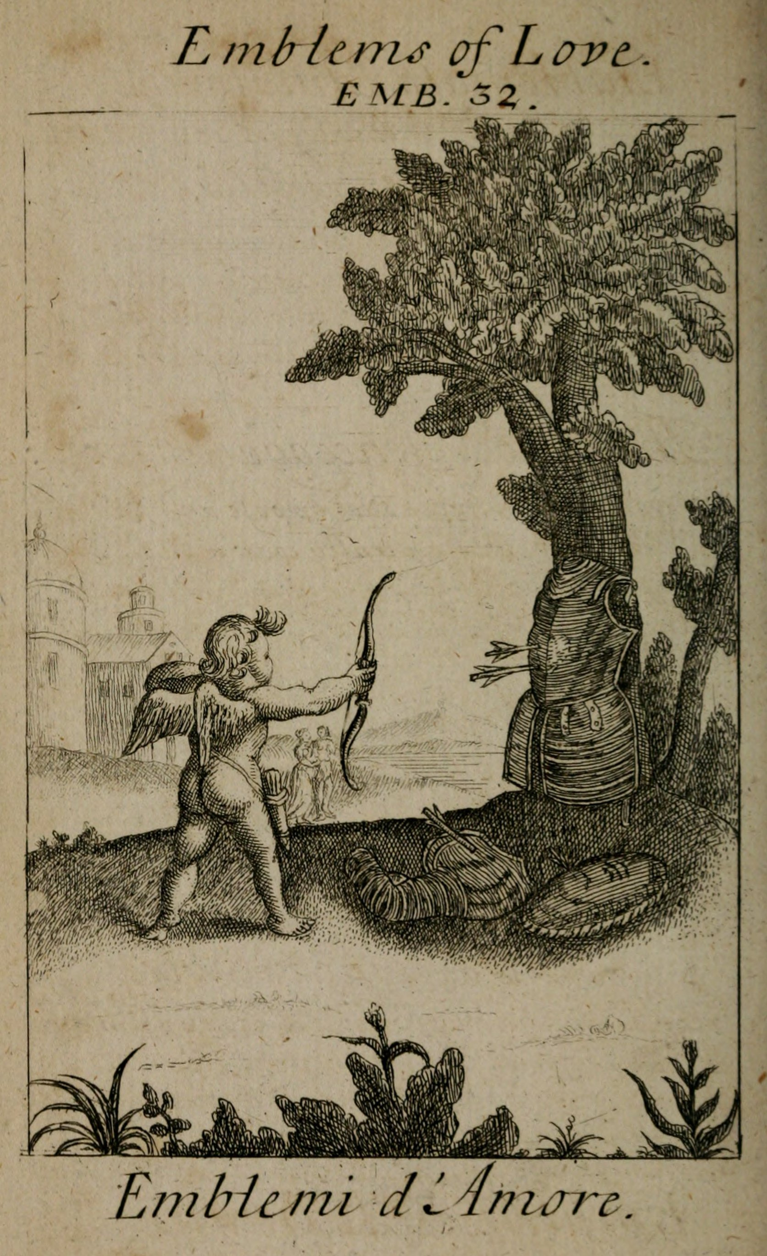
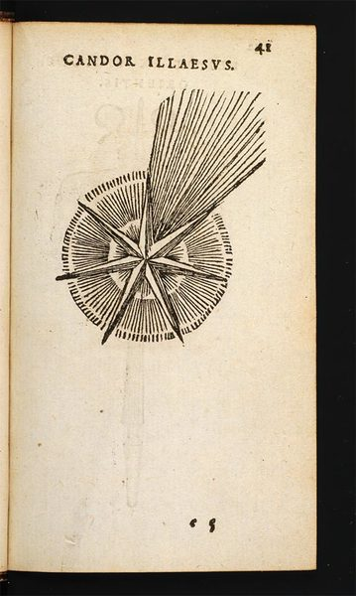
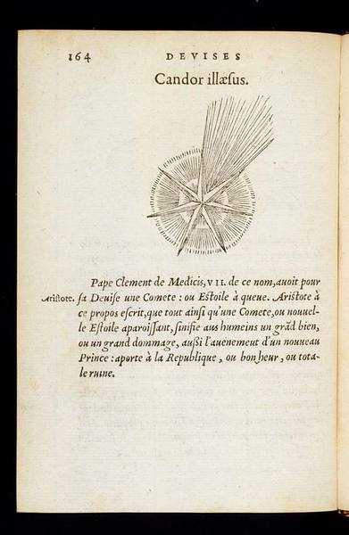
Issues:
Introduction
Diversity in illumination
Rotation
Scale
Research Question
Methods
Evaluation
Conclusions

Slide 8
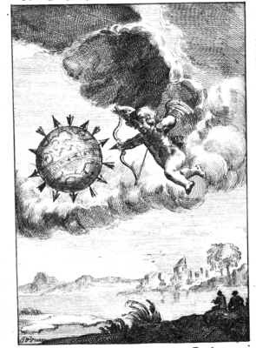
Segmentation: search for object inside image
Introduction
Research Question
Methods
Evaluation
Search for CUPID starting from object-query
Conclusions

Slide 9
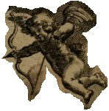
Search under transformation:
Introduction
Change of color/illumination
Research Question
Methods
Rotation
Evaluation
Scale
Conclusions

Slide 10
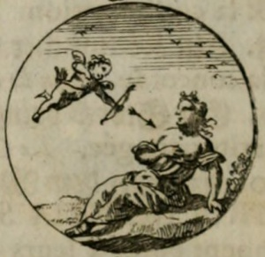
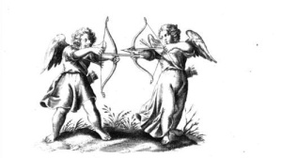
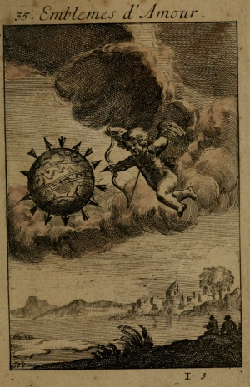
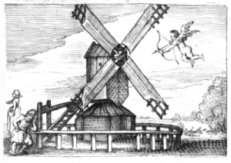
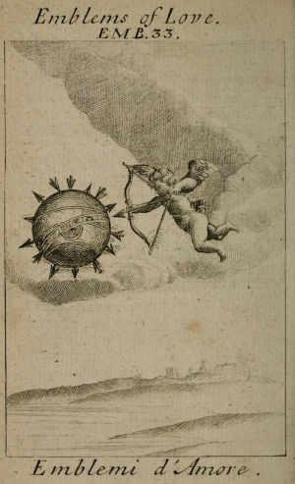
Similarity search:
Introduction
Research Question
Methods
Evaluation
Conclusions
Simulate Iconclass heading search:
92D1521- Cupid shooting a dart

Slide 11
Building image search engine:
Introduction
Classification vs Similarity.
Find similar images only analysing the query image!
Search for suitable feature to describe the image.
Construct an appropriate feature database for the desired application.
Research Question
Methods
Evaluation
Conclusions

Slide 12
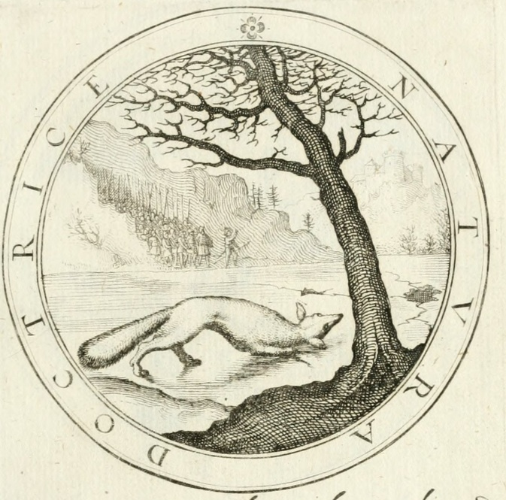
Building image search engine:
Introduction
Research Question
Extraction of local features
Descriptors for local features
“Bag of visual words” model
Methods
Evaluation
Conclusions

Slide 13
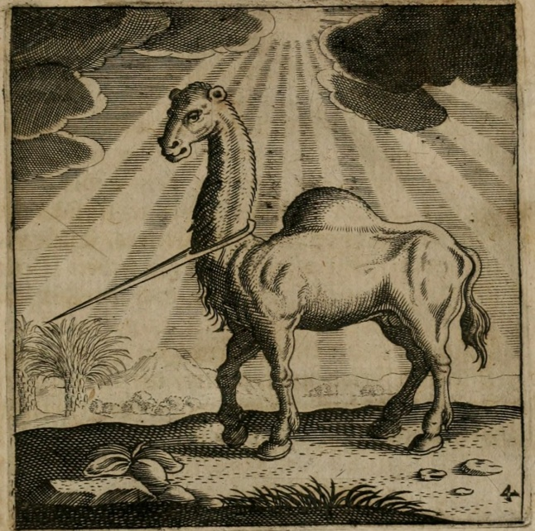
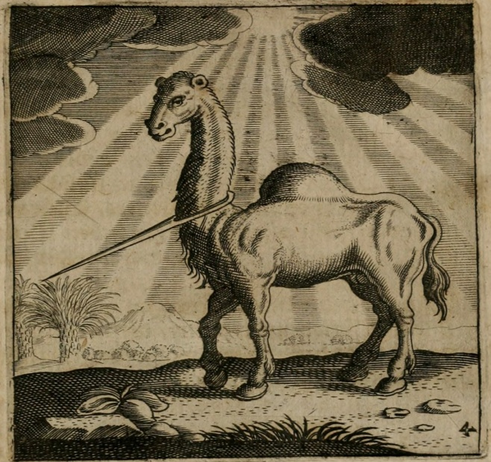
Search for suitable features:
Introduction
Research Question
Methods
Evaluation
Particular property of the image involving all pixels:
Colour histograms
Texture
Edges
Represent the image based on some salient regions (Keypoints or Interest points).
Interest point → scale, rotational and illumination invariance attributed.
Local features → more useful for image matching and object recognition.
Conclusions

Slide 14
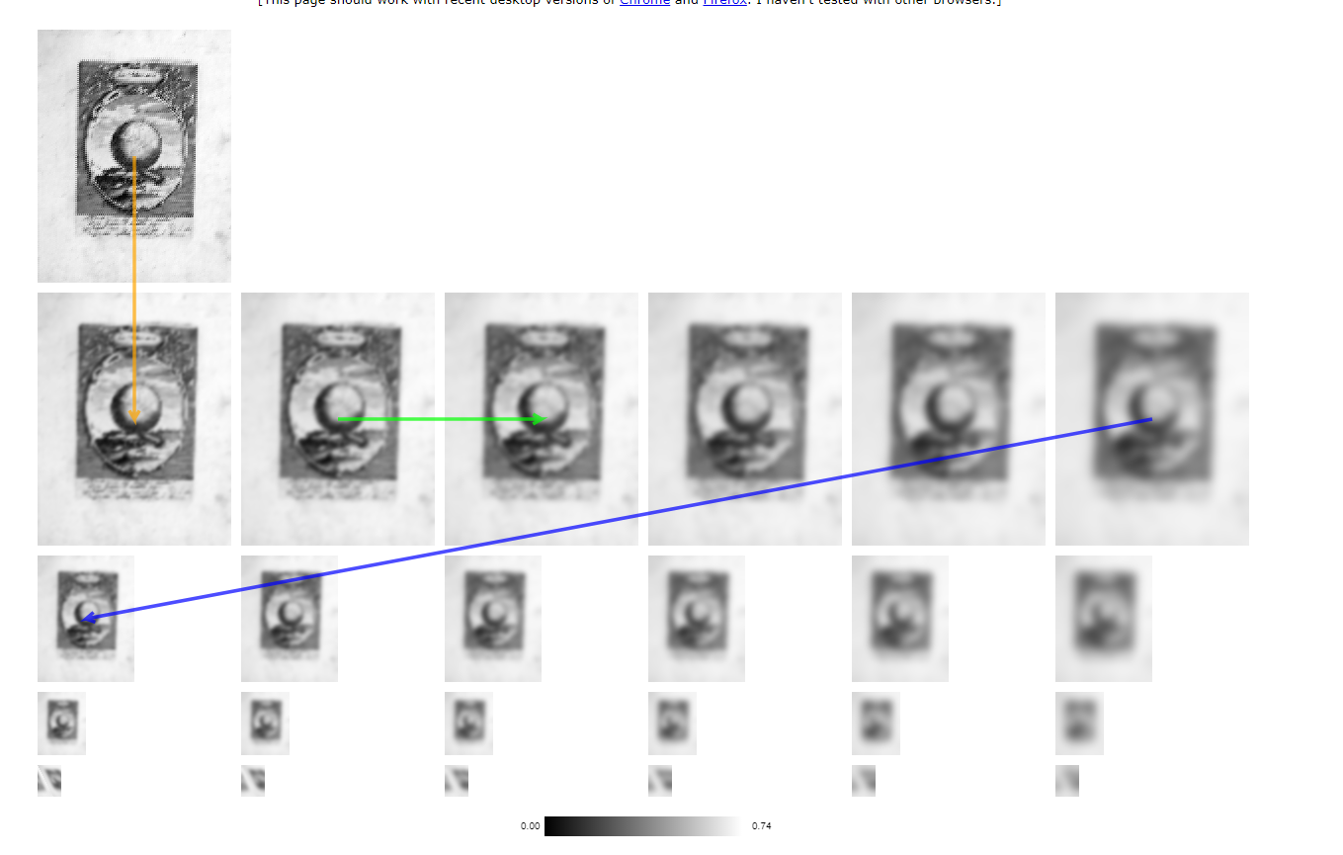
Keypoints anatomy: Scale Space
Introduction
Research Question
Blurring + Downsampling
Methods
Evaluation
Octave
1/2
Conclusions
1/4
1/8

Slide 15
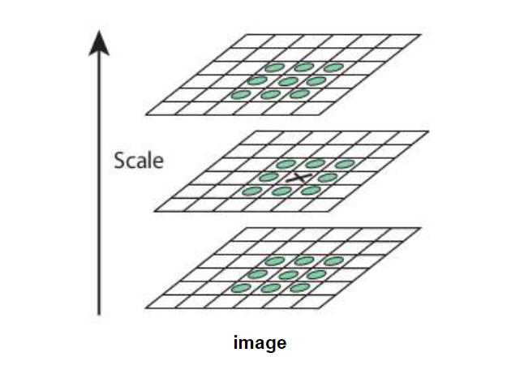
Keypoints anatomy: Discrete Extrema
Introduction
Research Question
One pixel in an image is compared with its 8 neighbours as well as 9 pixels in the adjacent pictures in the same octave.
Methods
Evaluation
Conclusions

Slide 16
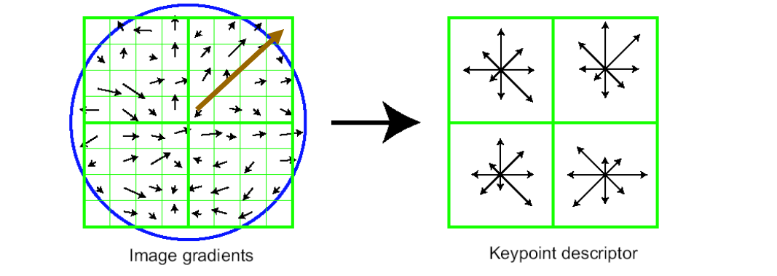
Keypoints anatomy: Compute Descriptors
Introduction
Research Question
They accept as input a keypoint frame, which has location, scale and orientation.
The neighbourhood is a circle and the coordinate system is rotated to match the reference orientation.
Keypoints might be discarded at this last step if their circle would not fit into the image
Methods
Evaluation
Conclusions

Slide 17
Feature Detectors and Descriptors
Introduction
Features detectors:
Single-scale (not invariant to scaling)
Harris Detector
FAST Detector
Multi-scale
LoG (Laplacian of Gaussian)
DoG (Difference of Gaussian)
FAST
Research Question
Features descriptor:
LBP
BRISK
ORB
SURF
SIFT
BRIEF
Methods
Evaluation
Conclusions
[…]

Slide 18
Combination of Detector/Descriptor
Introduction
Descriptor | ORB | BRIEF | SIFT | SURF | BRISK
Detector
ORB
FAST
SIFT
SURF
BRISK
Research Question
Methods
Evaluation
Similar content: 1) Scale-space representation 2) Key-point localization 3) Orientation assignment 4) Key-point descriptor
Conclusions

Slide 19
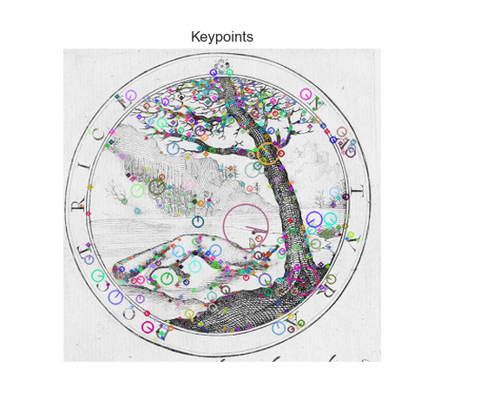
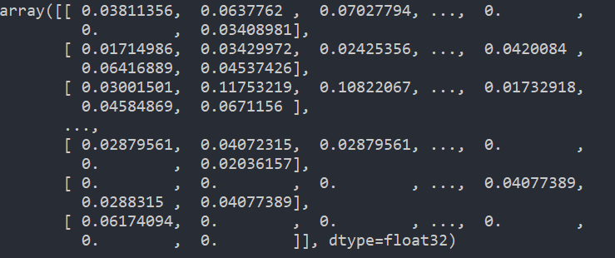
Keypoints and descriptors
Introduction
Research Question
Methods
Evaluation
Conclusions

Slide 20
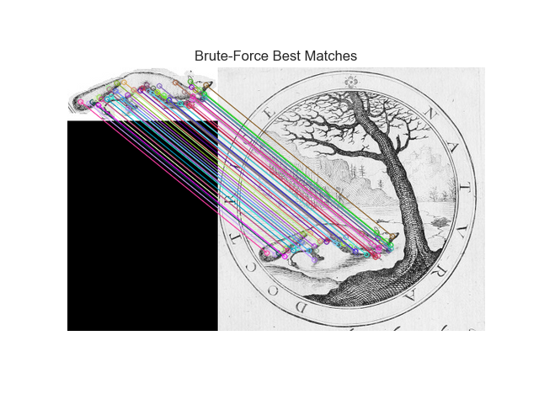
Matching
Introduction
Research Question
Methods
Evaluation
Conclusions

Slide 21
Building image search engine:
Introduction
Research Question
Extraction of local features
Descriptors for local features
“Bag of visual words” model
Methods
Evaluation
Conclusions

Slide 22
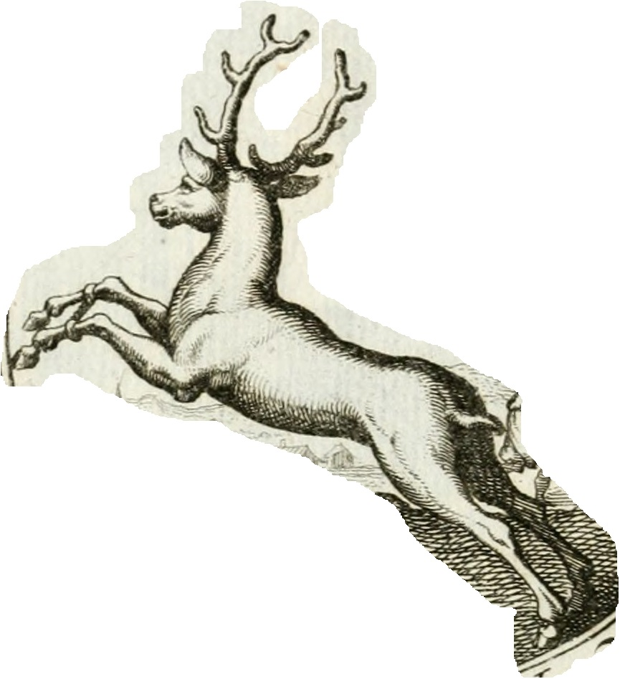
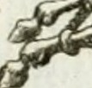
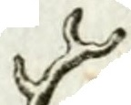
Bag of Visual Words
Introduction
Research Question
Methods
Evaluation
Conclusions

Slide 23
Bag of visual words model:
Introduction
Research Question
Extraction of local features form images database
Descriptors for local features
Clustering
Vocabulary (Visual Words)
Methods
Evaluation
Conclusions

Slide 24
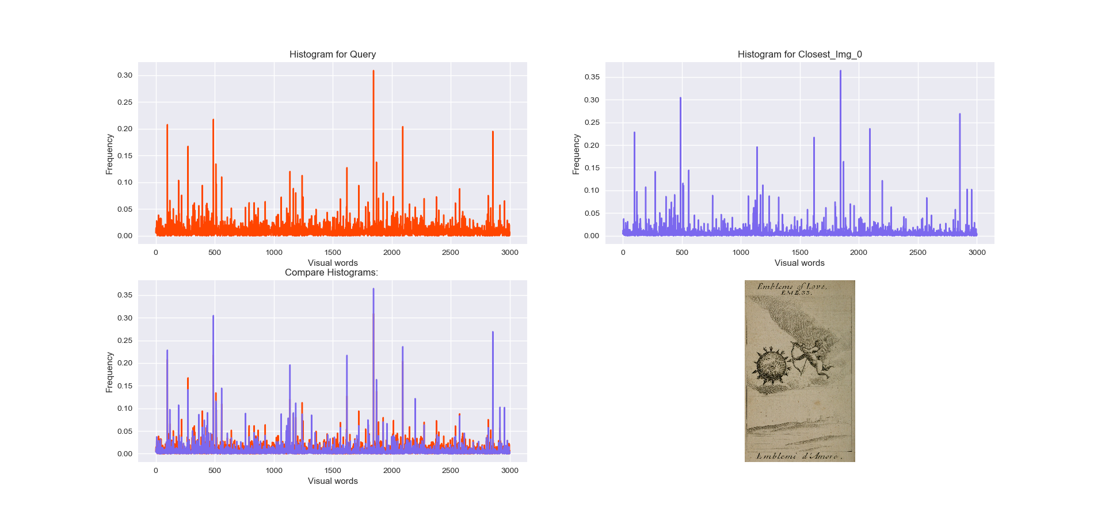
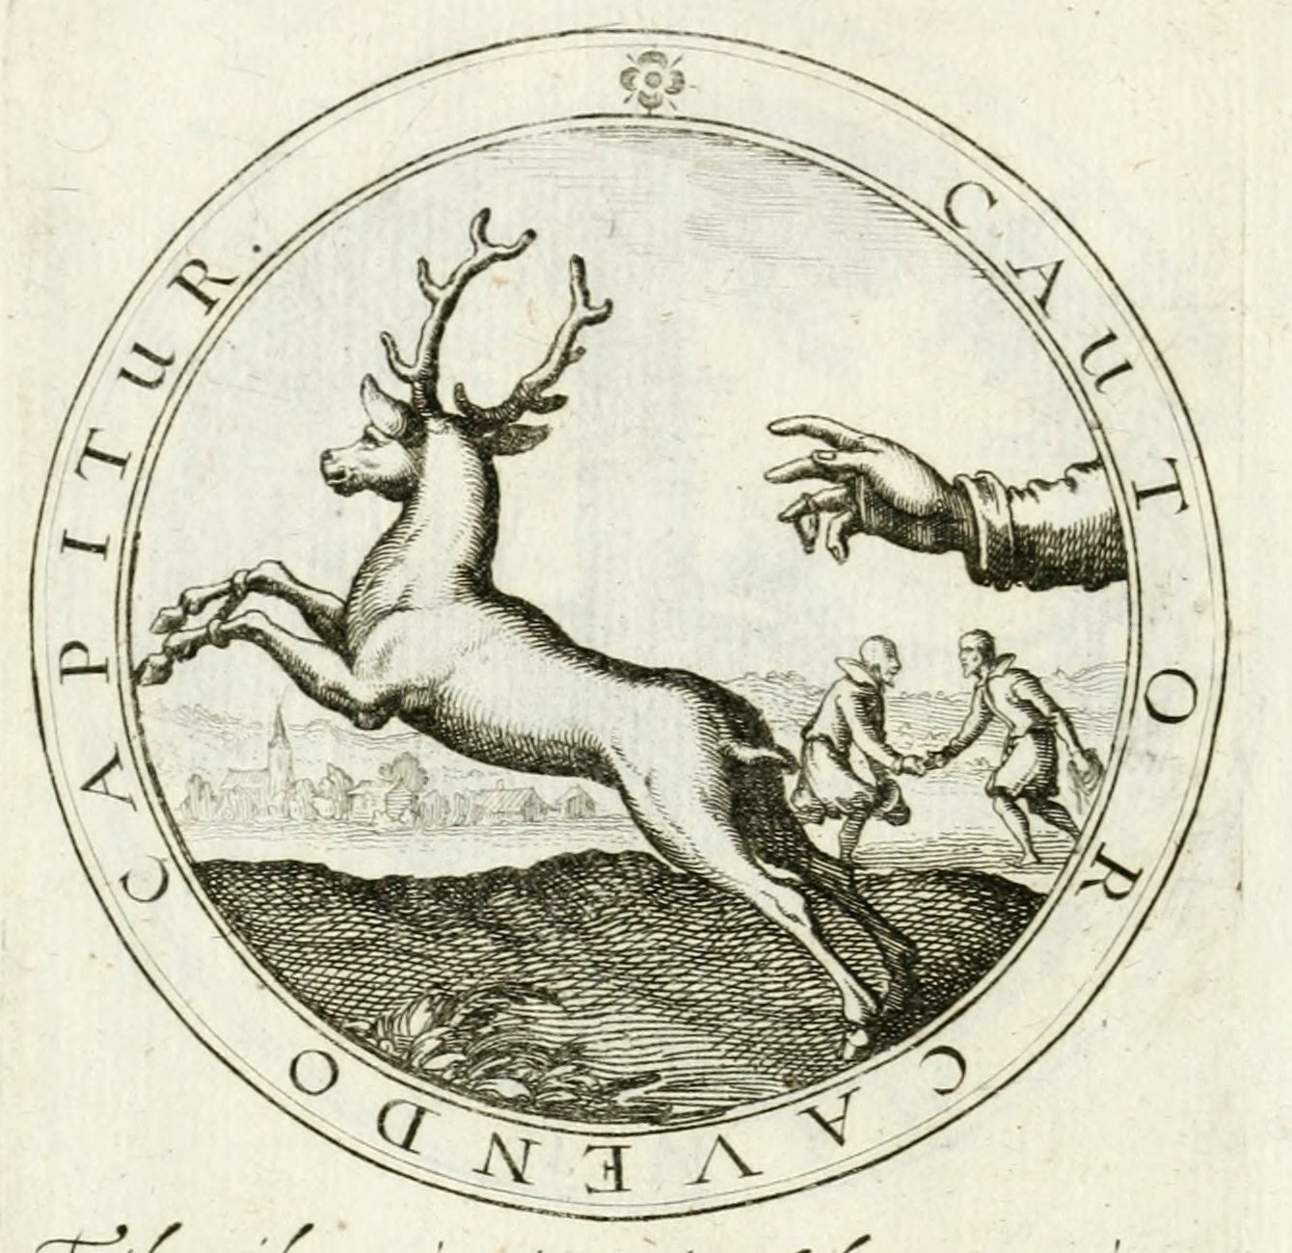
Bag of Visual Words: matching
Introduction
Research Question
Query Image
Methods
Evaluation
Conclusions

Slide 25
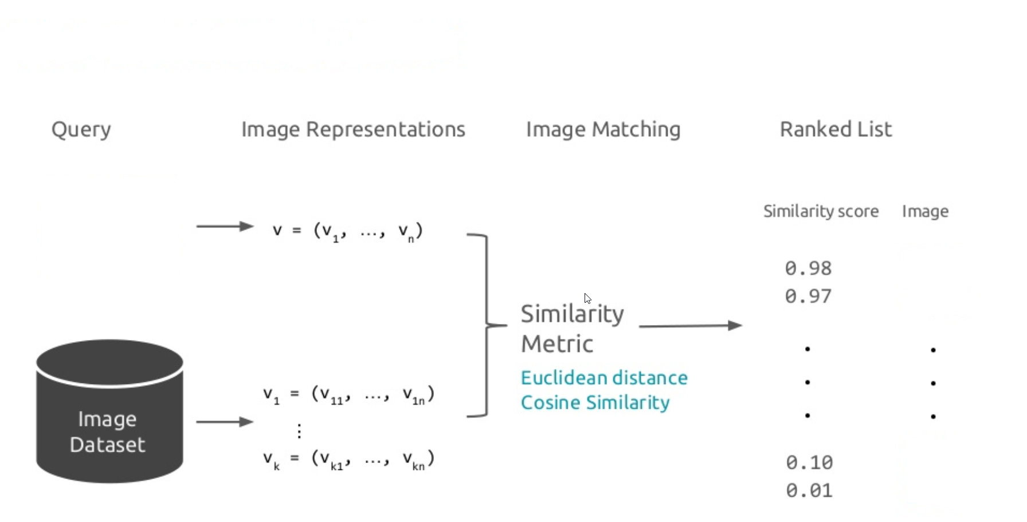
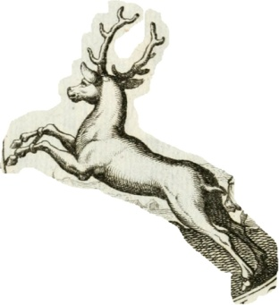
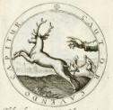
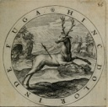
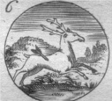
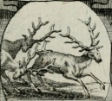
Bag of Visual Words: Retrieval pipeline
Introduction
Research Question
Methods
Evaluation
Conclusions

Slide 26
Performance analysis
Introduction
Test bench→400 images from Emblematica database.
Precision
Recall
F1-measure
Under transformation:
Rotation
Illumination
Scale
Qualitative analysis on detected visual words.
Research Question
Methods
Evaluation
Conclusions

Slide 27
Test Detector/Descriptor performance
Introduction
Descriptor | ORB | BRIEF | SIFT | SURF | BRISK
Detector
ORB
FAST
SIFT
SURF
BRISK
Research Question
Methods
Evaluation
Conclusions

Slide 28
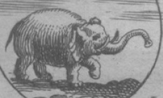
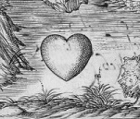
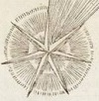
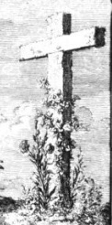
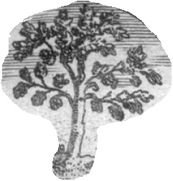
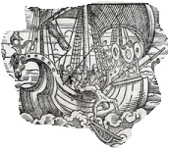
Query images:
Introduction
Research Question
Cupid
Methods
Heart
Elephant
Star
Flower
Evaluation
Lion
Conclusions
Sun
Vessel
Cross
Tree

Slide 29
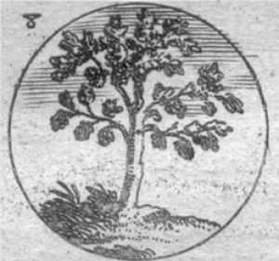
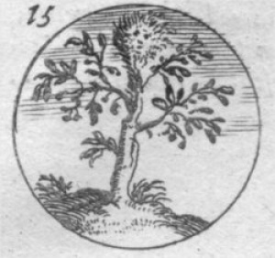
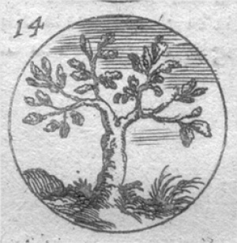
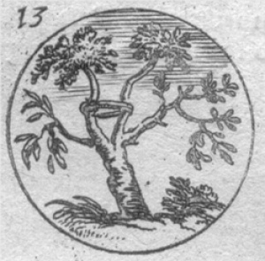
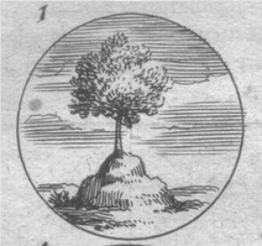
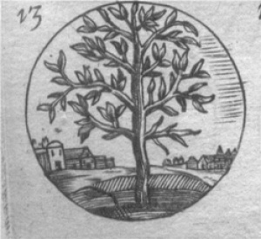
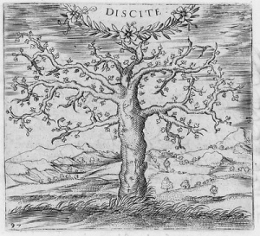
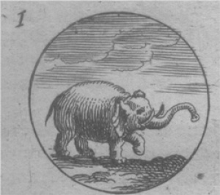
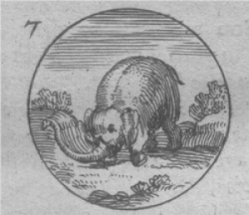
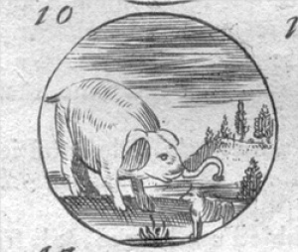
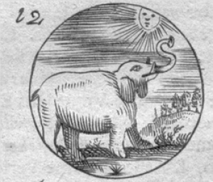
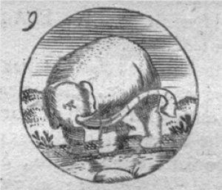
Query object and relevant images:
Introduction
Tree
Research Question
Methods
Elephant
Evaluation
Conclusions

Slide 30
Query object and relevant images:
Introduction
Flower
Research Question
Methods
Evaluation
Conclusions
Sun

Slide 31
Precision:
Introduction
Research Question
Number of correct results divided by the number of all returned results.
Methods
$$p=\frac{|\left\{relevant documents\right\} ∩ \left\{retrieved documents\right\}|}{|\left\{retrieved documents\right\}|}$$
Evaluation
Conclusions

Slide 32
Recall:
Introduction
Research Question
Number of relevant document that are returned.
Methods
$$r=\frac{|\left\{relevant documents\right\} ∩ \left\{retrieved documents\right\}|}{|\left\{relevant documents\right\}|}$$
Evaluation
Conclusions

Slide 33
F1-measure:
Introduction
Research Question
Is the average of Precision and Recall when they are close. This is the harmonic mean.
Methods
$$F=2∗\frac{precision∗recall}{precision+recall}$$
Evaluation
Conclusions
Notes:
Precision and recall are equally important. This means that we want both good results--> similar images and many of them.

Slide 34
Evaluation:
Introduction
Research Question
Methods
Evaluation
Conclusions

Slide 35
Evaluation under transformation:
Introduction
Change of illumination → gamma = 1.9
Rotation → 25°
Scale → of 100px
Research Question
Methods
Evaluation
Conclusions

Slide 36
Introduction
Research Question
Methods
Evaluation
Conclusions
Notes:
No results means:
No matches found → distance is to large
Even if the distance is ok he retrieved results are wrong → precision and recall are 0

Slide 37
Sift-Brisk:
Introduction
Research Question
Methods
Evaluation
Conclusions

Slide 38
Fast-Brisk:
Introduction
Research Question
Methods
Evaluation
Conclusions

Slide 39
Example of retrieved images for fast-brisk
Introduction
Flower
Research Question
Methods
1.09
1.23
1.252
1.253
1.2539
Evaluation
[…]
[…]
[…]
Conclusions
1.26
1.28
1.29

Slide 40
Detected visual words:
Introduction
Research Question
Methods
Evaluation
Conclusions
Notes:
The histogram here represents the frequency of the assignments. The vectors are not IDF(inverse document freqeuncy) and are not normalized.

Slide 41
Introduction
Research Question
1.09
Methods
Evaluation
Conclusions
1.23
Notes:
The plot here are from the normalized vectors.

Slide 42
Conclusions:
Introduction
Itroduction
Research Question
SEGMENTATION
Research Qustion
Methods
TRANSFORMATION
Evaluation
Conclusions
Conclusions
SIMILARITY

Slide 43
Thank you!

Slide 44
Issues:
Introduction
Different ways to display emblems:
Research Question
Methods
Evaluation
Conclusions
Notes:
non tutte le immagini sono state indicizzate con iconclass--> giustificazione al fatto che una ricerca per immagini serve

Slide 45
Search under transformation:
Introduction
Change of color/illumination
Research Question
Methods
Rotation
Scale
Evaluation
Conclusions

Slide 46
Keypoints anatomy: Difference of Gaussian
Introduction
Research Question
Compute the differences of the individual pixels.
Methods
Evaluation
Conclusions

Slide 47
Keypoints anatomy: Difference of Gaussian
Introduction
Research Question
Increase the visibility of edges and other detail present in a digital image
Bright spots→ increase of brightness
Dark spots→ increase of darkness
Methods
Evaluation
Conclusions

Slide 48
Keypoints anatomy: Discrete Extrema
Introduction
Research Question
Discrete maximum/minimum → a pixel whose grey value is larger/smaller than those of its 26 “neighbour”.
Mark it as Keypoint → significant different from surrounding area.
Methods
Evaluation
Conclusions

Slide 49
Keypoints anatomy: Assign Reference Orientation
Introduction
Research Question
Observes if the gradients in the direct neighbourhood of the point have approximately the same direction and takes dominant direction.
Keypoints:
near the image border which don't have enough neighboring pixels to compute a reference orientation are discarded.
without a dominating orientation are discarded.
with more than one dominating orientation might appear more than once in the next steps, namely once per orientation.
Methods
Evaluation
Conclusions

Slide 50
Keypoints anatomy: Assign Reference Orientation
A SIFT descriptor is a 3-D spatial histogram of the image gradients in characterizing the appearance of a keypoint.
The gradient at each pixel is regarded as a sample of a three-dimensional elementary feature vector, formed by the pixel location and the gradient orientation.

Slide 51
Keypoints anatomy: Assign Reference Orientation
Gradient magnitude and orientation at each point weighted by a Gaussian
Orientation histograms: sum of gradient magnitude at each direction
4x4 arrays of 8 bin histogram is used, a total of 128 features for one Keypoint.

Slide 52
Keypoints anatomy: Compute Descriptors
Introduction
Research Question
They accept as input a keypoint frame, which has location, scale and orientation.
From Keypoints list a 4x4 arrays of 8 bin histogram is computed for the distribution of the directions of the gradients in a neighbourhood (128 features for each Keypoint).
Methods
The neighbourhood is a circle and the coordinate system is rotated to match the reference orientation.
Keypoints might be discarded at this last step if their circle would not fit into the image
Evaluation
Conclusions

Slide 53
Clustering example:
Introduction
Research Question
Methods
Evaluation
Conclusions

Slide 54
Introduction
Research Question
Methods
Evaluation
Conclusions
Notes:
The plot here are from the normalized vectors.

